Slide 1


Learning from incidents starting improvement
Linda Drupsteen
with Jop Groeneweg and Gerard Zwetsloot

Slide 2

Delays
Disturbances
Any information can be used to learn from
if you are able to learn
Near misses
Early warnings

Slide 3
Back to the basics

Slide 4
Learning from incidents
Learn lessons
Use lessons learned
Share information

Slide 5
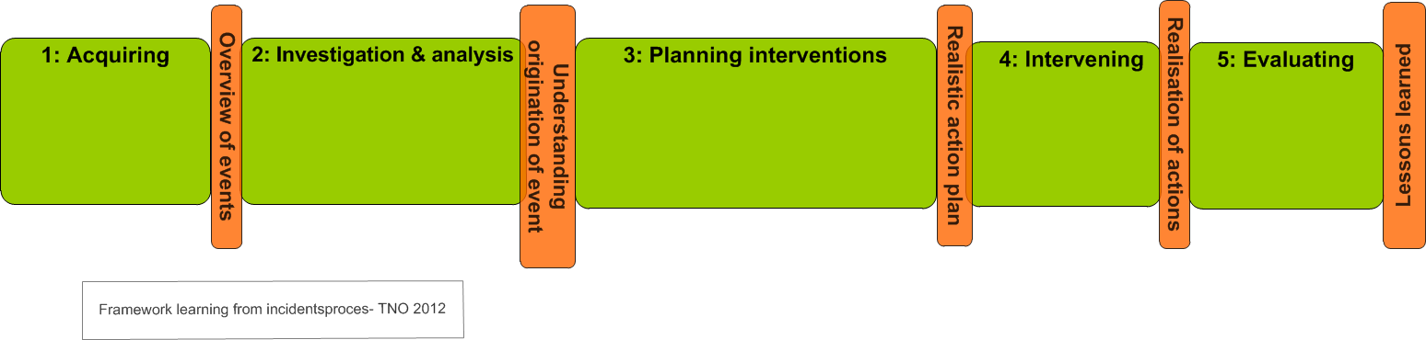
Learning from incidents process
Learn lessons
Use lessons

Slide 6
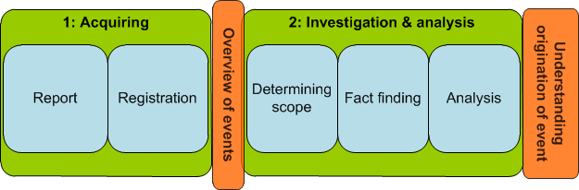
Learning lessons

Slide 7
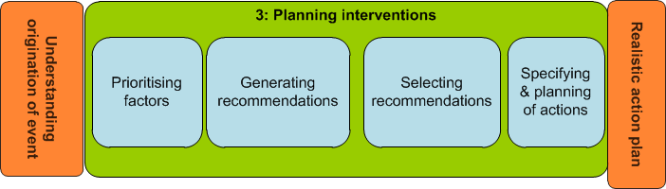
Bridging the gap

Slide 8
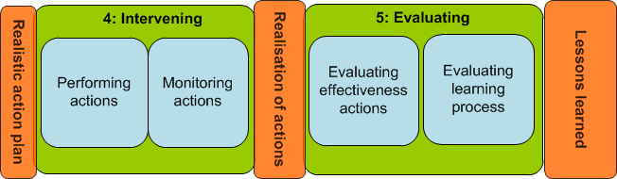
Use lessons learned

Slide 9
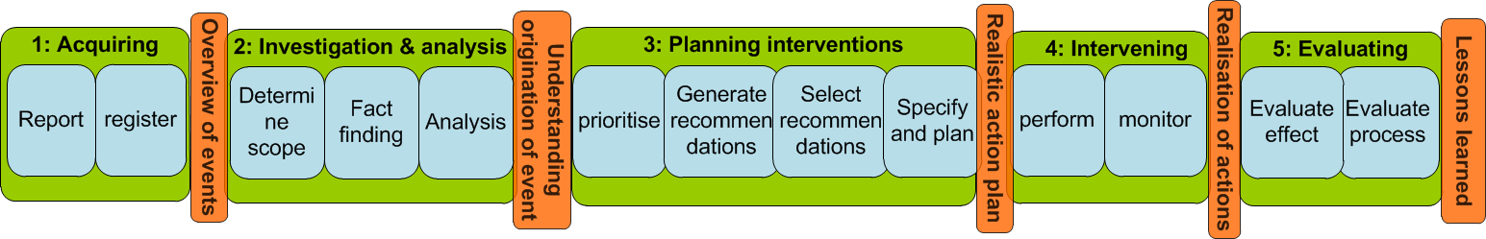
Learning from incidents

Slide 11
How can we improve learning?

Slide 12
Quickscan
http://quickscan.learningfromincidents.com
How well is this step formally organised?
How well does it work in daily practice?
Result: weak steps and weak phases

Slide 13
Optimising the learning process

Slide 14
What do you aim to improve?
Problems
lack of trust
not recognised as relevant
“won’t be used anyway”
Problem
e.g. incident not reported
Problem
ineffective learning

Slide 15

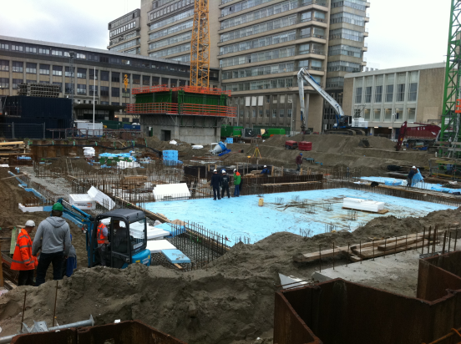
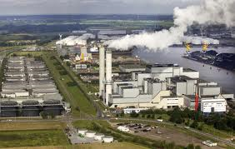
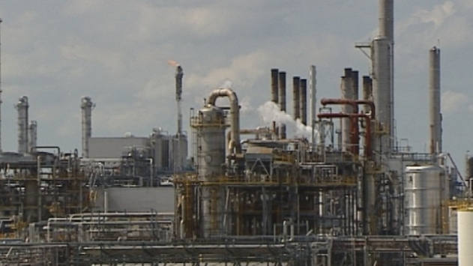
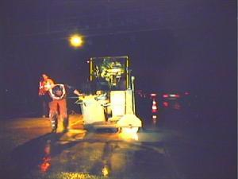
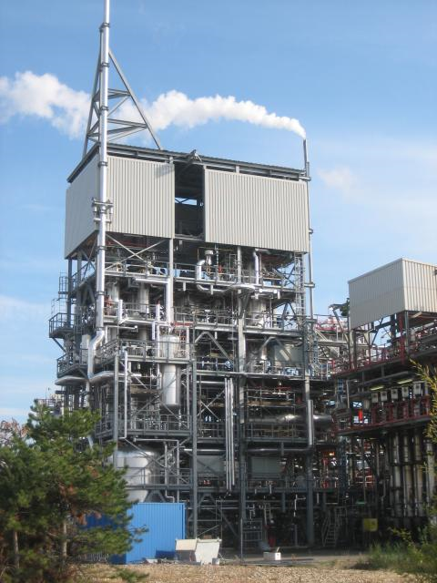
Case studies: how do organisations learn from incidents?

Slide 16
Repair on wrong pipeline
More important: why was not learned from it?
Repair work had to be done at a specific pipe that was exactly located at the cross section of two plants. The work was prepared by people from plant 1,and executed by people from plant 2. However, the work was by mistake performed on the wrong pipe. A solution was thought out after an earlier, similar incident but this hadn’t been implemented yet.

Slide 17
Case 1
Inefficient learning from incident ‘repair pipeline’
Remedial actions not performed
Too many actions, too little budget
No prioritization, no ownership
etc

Slide 18
Direct causes (in the real world)
Not performed, not performed well or not effective
Incidents are not always recognized
Incidents are not reported
Plans are not related to outcomes of analyses
Many actions remain unaddressed
The effectiveness of actions is not evaluated

Slide 19
Latent conditions
Structure and systems
People
Communication
Organisational values and expressions
Procedures
Management systems
Resources
Motivation
Competence
Ownership
Sharing
Storing
Feedback
Culture
Openness
Trust
Core values
Management commitment

Slide 20
Summary
Learning process of learning lessons and using them
Many input possible, but only useful if process is optimised
Loss of learning potential in every phase
There is a difference between paper and practice
Loss of potential is due to direct and indirect causes

Slide 21
There is no simple solution for
ineffective learning

Slide 22
However (conclusion)
You can start learning to learn, by:
Use your knowledge
Find the weaknesses
quickscan, ‘accident’ analysis, case study
Optimising the full learning process

Slide 23
For More information
Linda.Drupsteen@tno.nl
http://nl.linkedin.com/in/lindadrupsteen

